Slide 1


INDIAN INSTITUTE OF MATERIALS MANAGEMENT
VADODARA BRANCH
EVENING TALK: LOGISTICS & OPERATION SINDOOR
DATE: 12.07.2025 AT 18.30 PM
VENUE: IIMM HALL
SPEAKER: AIR WARRIOR DINESH PATEL

Slide 2
SPEEKERS PROFILE
5th Term President of Poorva Sainik Seva Parishad
Ex-President – Bita – 5 times
1971 Indo-Pak war participant
17 years of service with Indian Air Force.
15 years in IT business as Disu System
Winner of two car rallies
Author of two books (i) Fail to Win & (ii) Sell to Win
Passionate of Yoga & Gardening
Life coach and trained more than 10,000 people.
The speaker has participated in a significant number of television debates on the subject.

Slide 3
IIMM Vadodara Branch successfully organized an engaging Evening Talk on the theme “Logistics & Operation Sindoor” by Air Warrior Dinesh Patel on 12th July, 2025 at IIMM Conference Room. The session featured esteemed Ex-Army officers who shared valuable insights drawn from their firsthand experience with logistics during wartime operations. Their in-depth perspectives on the strategic and operational aspects of military logistics captivated the audience. The event received high appreciation for the speakers, the subject matter and the overall execution.

Slide 4
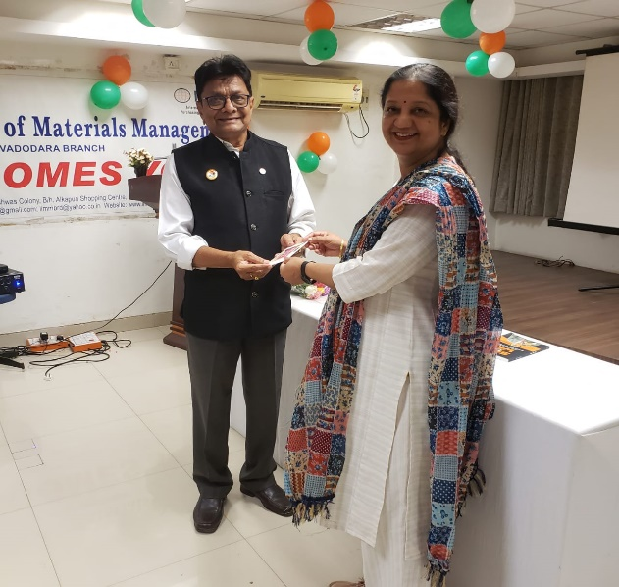

Slide 5
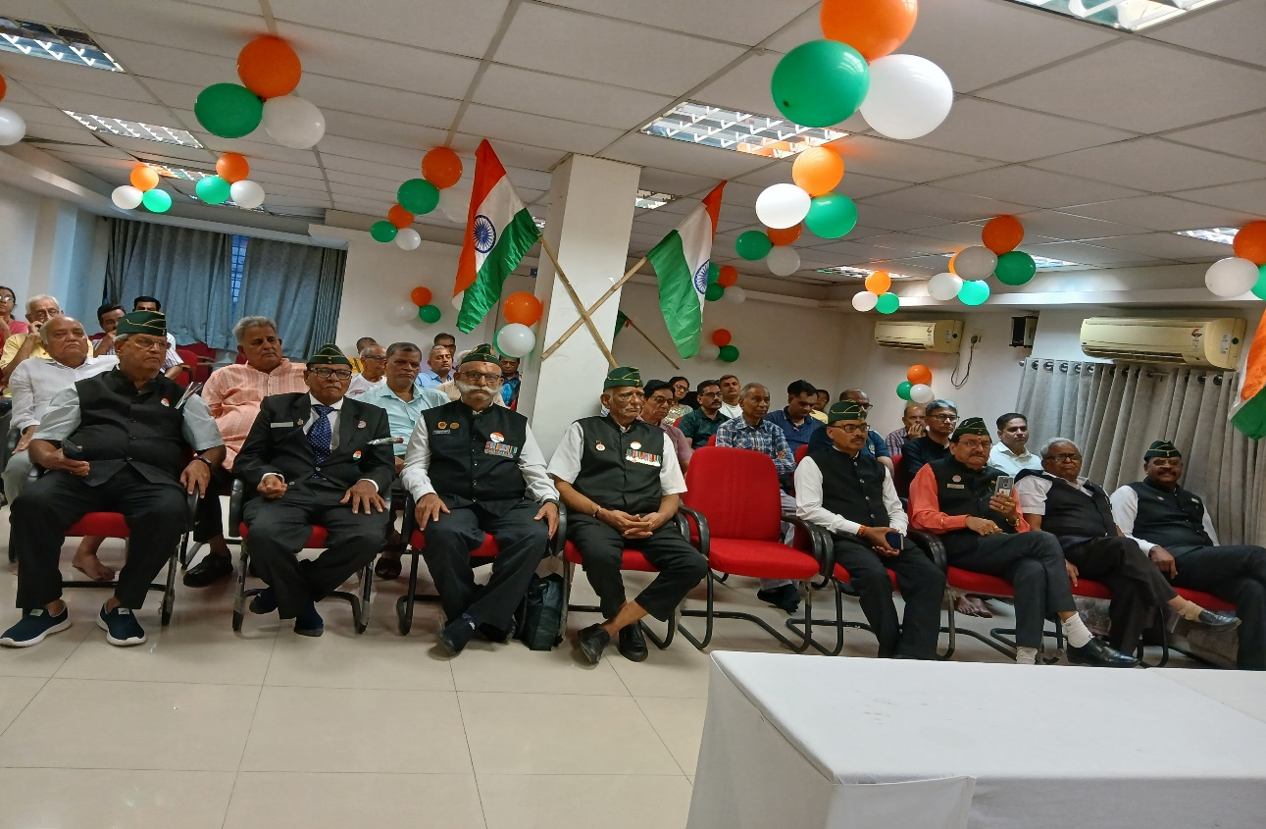

Slide 6
